Slide 1


Technical background
presentation
Team: 5G

Slide 2

List
table of contents
1
Data crawling
2
Architecture
3
Models
ⓒSaebyeol Yu. Saebyeol’s PowerPoint

Slide 3


Part 1
Web Crawling
ⓒSaebyeol Yu. Saebyeol’s PowerPoint

Slide 4
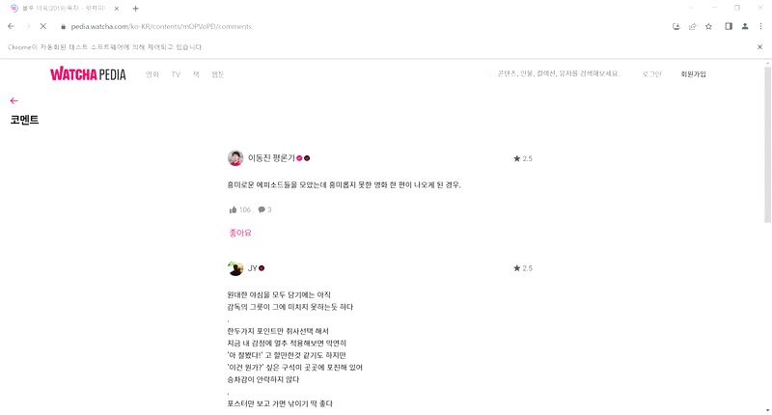

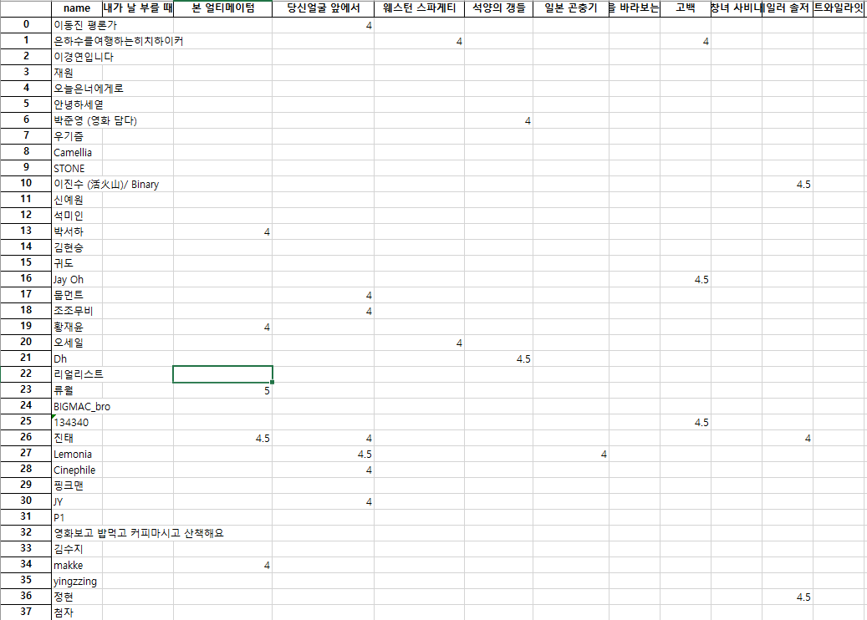

Part 2
Data Crawling

Slide 5
Part 2
Data Crawling

Slide 6

Part 2
Architecture
ⓒSaebyeol Yu. Saebyeol’s PowerPoint

Slide 7

Part 2
Recommendation system

Slide 8
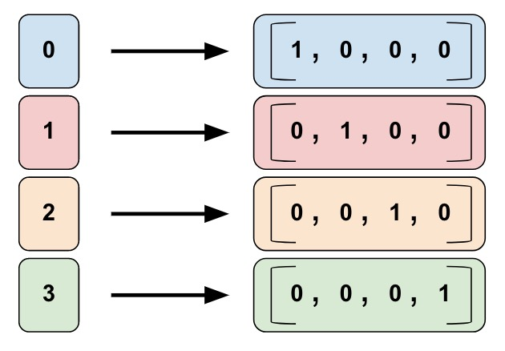
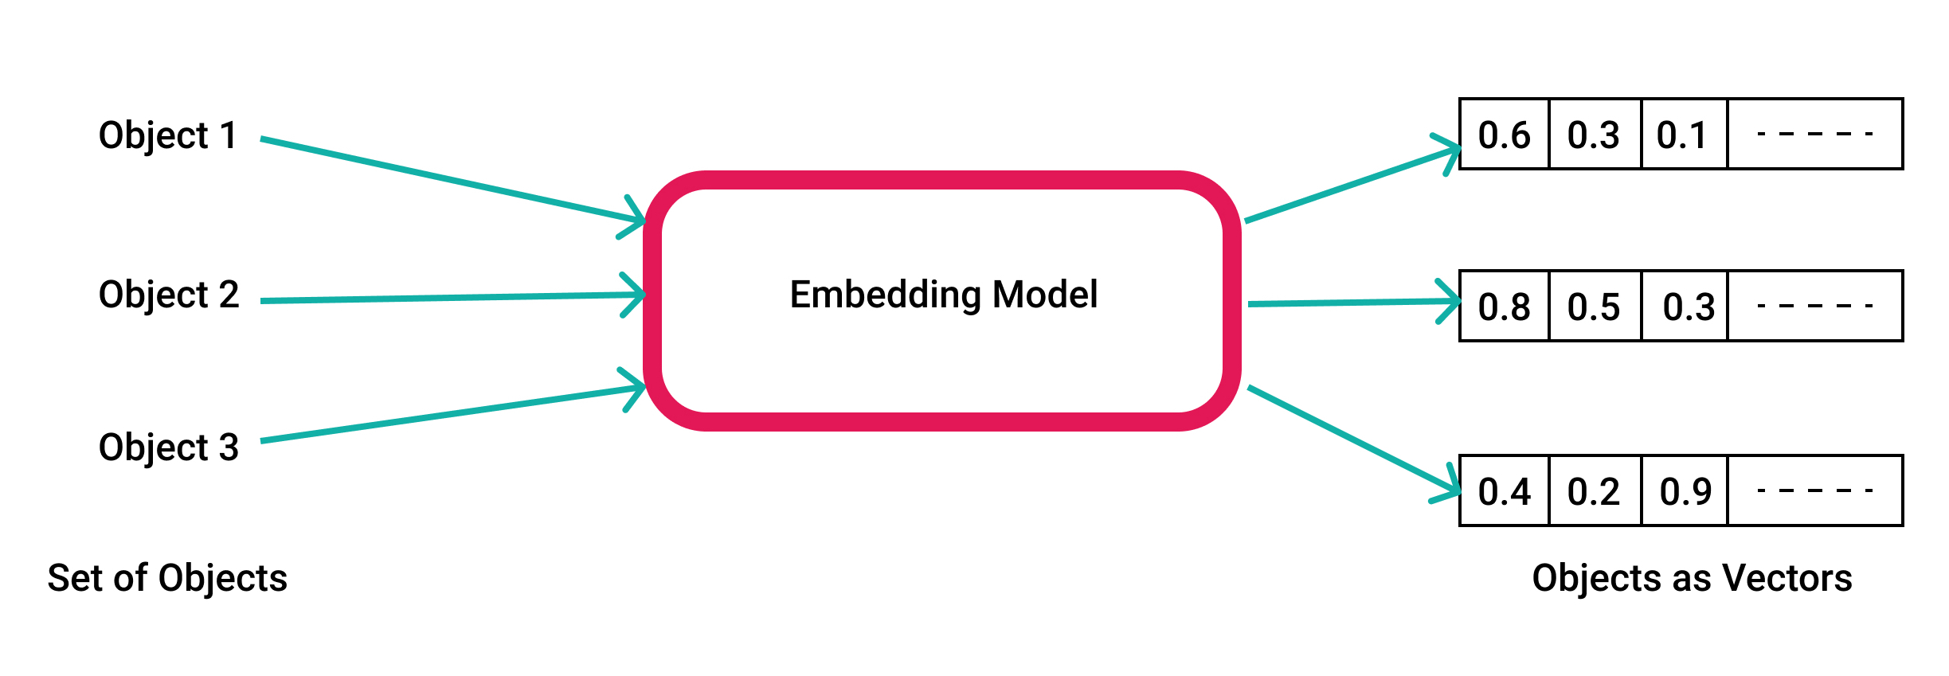
Part 2
Content Based Filtering
Genre, Country, year, ... -> one hot encoding
Title, description … -> Embedding
Cosine similarity, Pearson correlation coefficient

Slide 9
Part 2
Contents based Filtering Architecture
Drama Title
Title Embedding
Drama Genre
Genre Embedding
Pretrained Model
koBERT
Webtoon Title
Title Embedding
Webtoon description
Description
Embedding
Movie Title
Title Embedding
Genre Embedding
Movie description

Slide 10
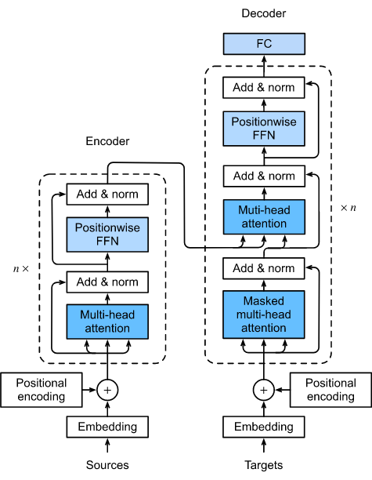
Bert
Part 2
Transformer encoder
Self-attention
Use key query value
Using relevance weighted sum
Notes:
In the previous presentation, our team said that we would use both contents-based model and collaborative filtering method, and I will introduce specifically how to design contents-based model. Our team will use data from three different domains, so we need a way to compare them at once. To this end, we plan to convert the title and genre to embedded vector using koBERT.

Slide 11
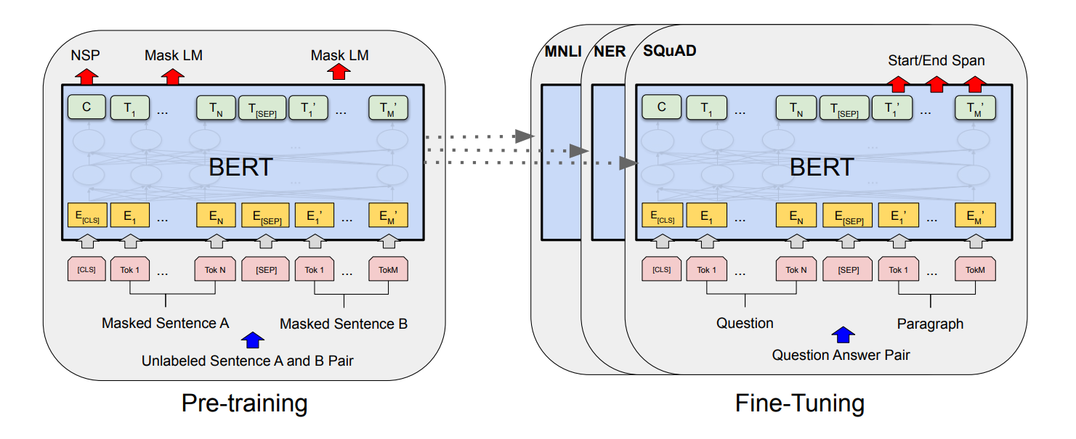
Part 2
Content Based Filtering - Bert
BERT : Bidirectional Encoder Representations from Transformer
Pre-training + fine tuning
Pre-training : unsupervised learning with unlabeled data
Fine-tuning : with labeled data, tuning the parameter for specific tasks

Slide 12
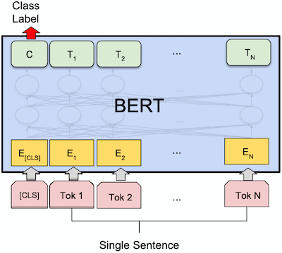
Bert
Part 2
Bert
Masked token prediction
predict masked token
Next sentence prediction
Predict next sentence
Notes:
In the previous presentation, our team said that we would use both contents-based model and collaborative filtering method, and I will introduce specifically how to design contents-based model. Our team will use data from three different domains, so we need a way to compare them at once. To this end, we plan to convert the title and genre to embedded vector using koBERT.

Slide 13







Part 2
Contents based Model architecture
Calculate the relevance of embedding
Notes:
After the conversion, we recommend topk items with high similarity by calculating the similarity to the content that the user has seen or likes. Since it is a method of utilizing word embedding, even contents in other domains will work effectively. For example, for users who like The Glory, we recommend Taken, a similar genre of movie.

Slide 14
Part 2
CF Model architecture
target
target
target
BPR Loss
User1
drama encoder
webtoon encoder
movie encoder
Drama1
Webtoon1
Movie1

Slide 15
Part 2
Encoder design
Experiment1
Parameter sharing
drama encoder
webtoon encoder
Movie encoder
Experiment2
Use independent parameters
drama encoder
webtoon encoder
movie encoder

Slide 16
Part 2
Encoder design
Ensemble method
itemKnn, userKnn, NeuMF, BPR, Simplex, Biser, EASE, LightGCN, multVAE, FM
aggregation
Voting, weighted sum
model1
model2
model3
model4
제목을 입력하세요
Drama1

Slide 17


Part 3
Model
ⓒSaebyeol Yu. Saebyeol’s PowerPoint

Slide 18
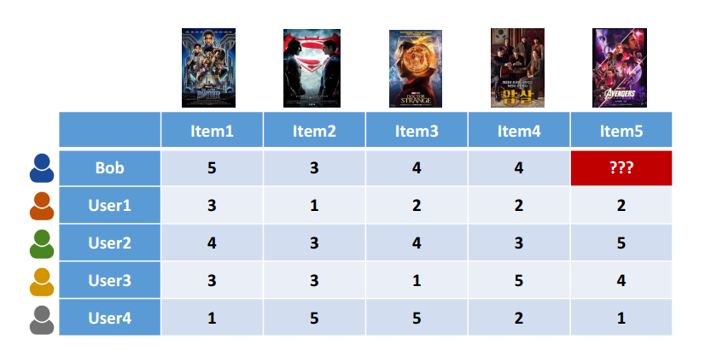
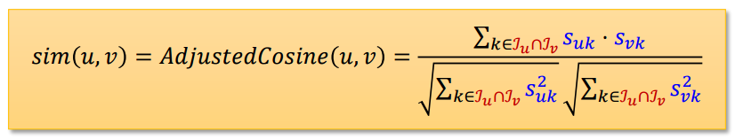
Part 3
User KNN

Slide 19
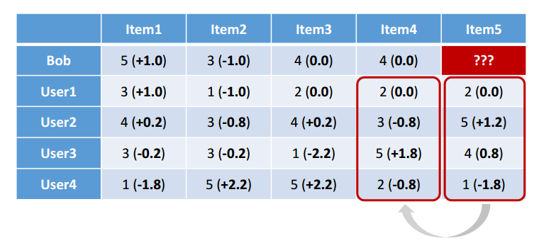
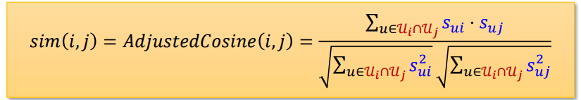
Part 3
Item KNN

Slide 20
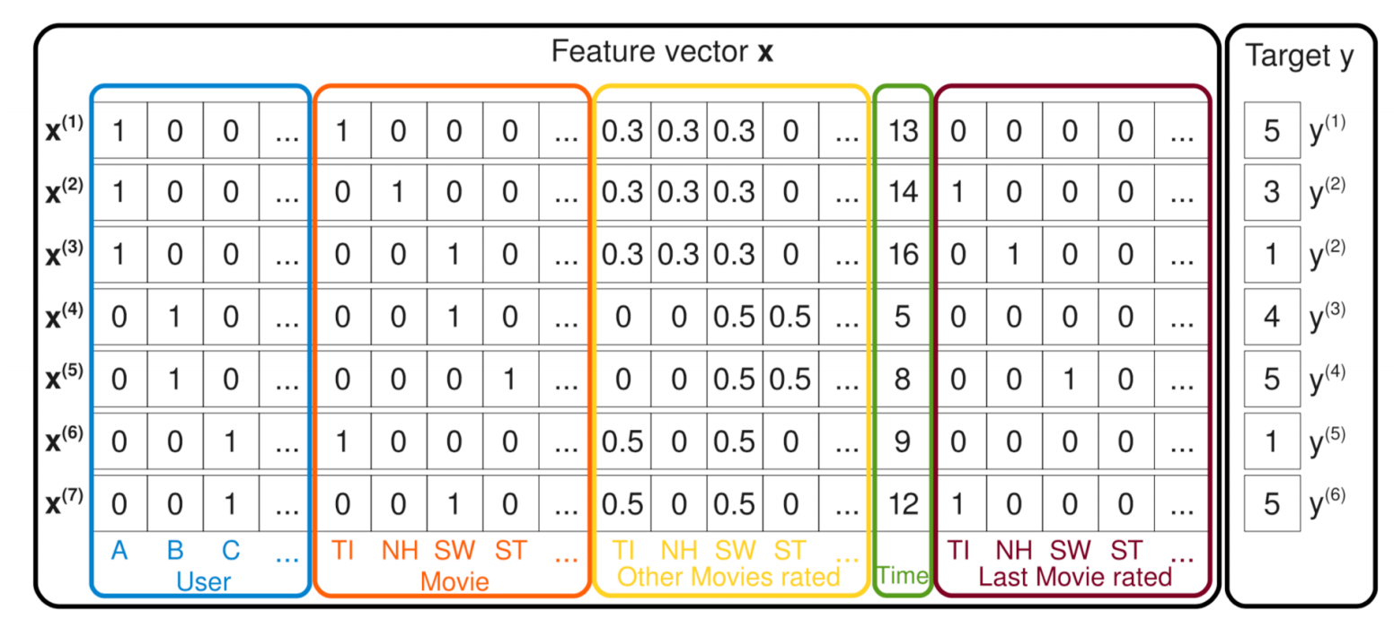
Part 3
Factorization machine

Slide 21

Q&A
ⓒSaebyeol Yu. Saebyeol’s PowerPoint

Slide 22

감사합니다

